Slide 1

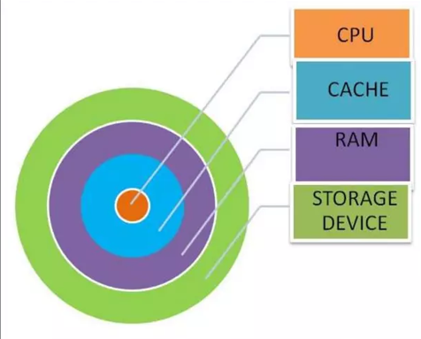
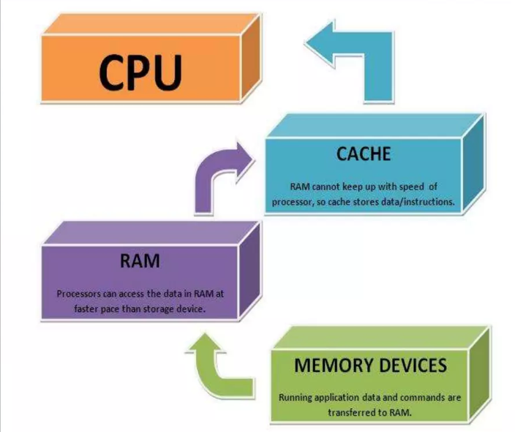
Introduction Of Cache Memory
LEVEL 1 (L1) internal cache
LEVEL 3 (L3) Main memory
LEVELS OF CACHE MEMORY
LEVEL 2(L2) CACHE MEMORY
How it works?
CACHE MEMORY
Levels of memory:
How Cache memory works?
L1 cache is the fastest memory that is present in CPU chip itself. In terms of priority of access, L1 cache has the data the CPU is most likely to need while competing a certain task. its size is often restricted to between 8KB and typically goes up to 256KB.L1 cache is usually split two ways, into the instruction cache and the data cache. The instruction cache deals with the information about the operation that the CPU has to perform, while the data cache holds the data on which the operation is to be performed
L3 Level 3 (L3) cache is the largest cache memory unit, and also the slowest one. It can range between 1MB to upwards of 8MB. Modern CPUs have dedicated space on the CPU die for the L3 cache, and it takes up a large chunk of the space. L2 and L3 caches are bigger than L1. They are extra caches built between the CPU and the RAM. Sometimes L2 is built into the CPU with L1. L2 and L3 caches take slightly longer to access than L1. The more L2 and L3 memory available, the faster a computer can run.
Level 2 (L2) cache is slower than L1 cache, but bigger in size. Its size typically varies between 256KB to 512 KB, although the newer, powerful CPUs tend to go past that. L2cache holds data that is likely to be accessed by the CPU next. In most modern CPUs, theL1 and L2 caches are present on the CPU cores themselves, with each core getting its own cache.
Level 1 (L1) Internal cache.
Level: 2 (L2) Cache memory.
Level: 3 (L3) Main memory.
THANK YOU.
Cache memory is a very high speed semiconductor memory which can speed up the CPU. It is small amount random access memory (RAM) built directly within the processor. It is used to temporarily hold data and instructions that the processor is likely to reuse. It acts as a buffer between the CPU and main memory.
MEMORY ORGANIZATION
The memory organization of the system is shown below:
At the core is CPU,
Cache memory,
RAM,
Storage device.
PREPARED BY: DEEPAN GURUNG
Class: XI
Subject: Computer science
School: VSSS

Slide 2
MEMORY ORGANIZATION

Slide 4
THANK YOU

